Slide 1


Sybex CCNA 640-802
Chapter 11: VLAN’s
Instructor & Todd Lammle

Slide 2

Chapter 11 Objectives
The CCNA Topics Covered in this chapter include:
What is a VLAN?
VLAN Memberships
VLAN links
Frame tagging
VTP, RSTP,PVSTP, 802.1q
Trunking
Configuring VLANs
Inter-VLAN Communication
Configuration examples

Slide 3
Virtual LANs (VLANs)
Definition: A logical grouping of network users and resources connected to administratively defined ports on a switch.
  Smaller broadcast domains
  Organized by:
    Location
    Function
    Department
    Application or protocol

Slide 4
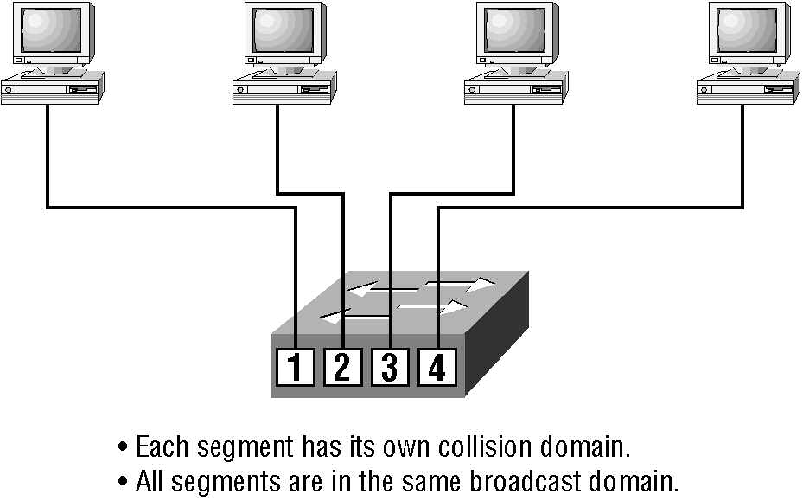
Switches

Slide 5
Features of VLANs
Simplify network management
Provides a level of security over a flat network
Flexibility and Scalability

Slide 6
Broadcast Control
Broadcasts occur in every protocol
Bandwidth & Broadcasts
Flat network
VLANs & Broadcasts

Slide 7
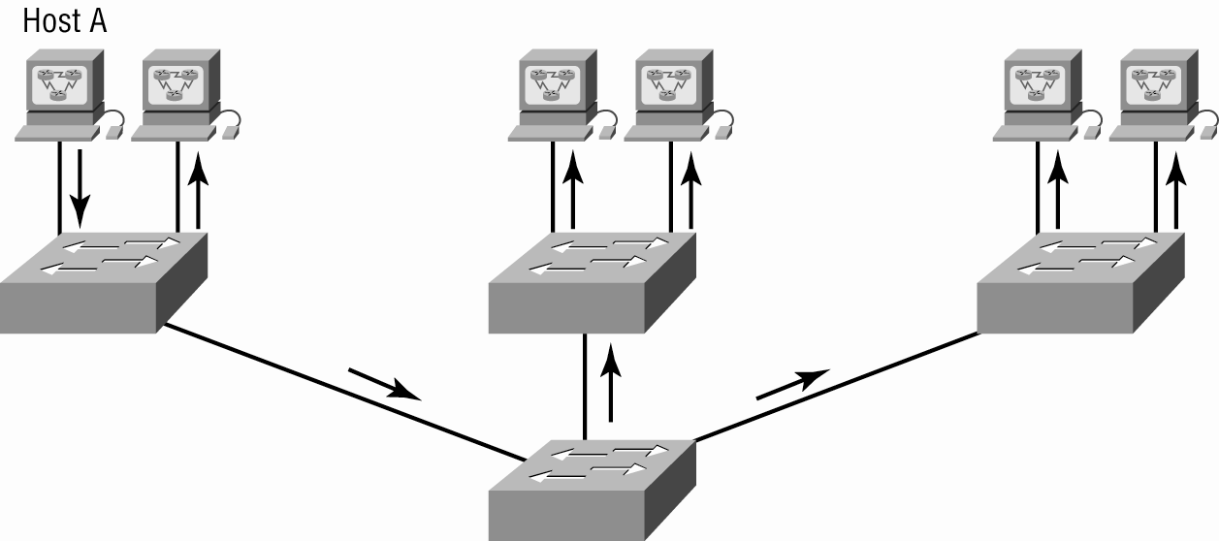
Flat Network Structure

Slide 8
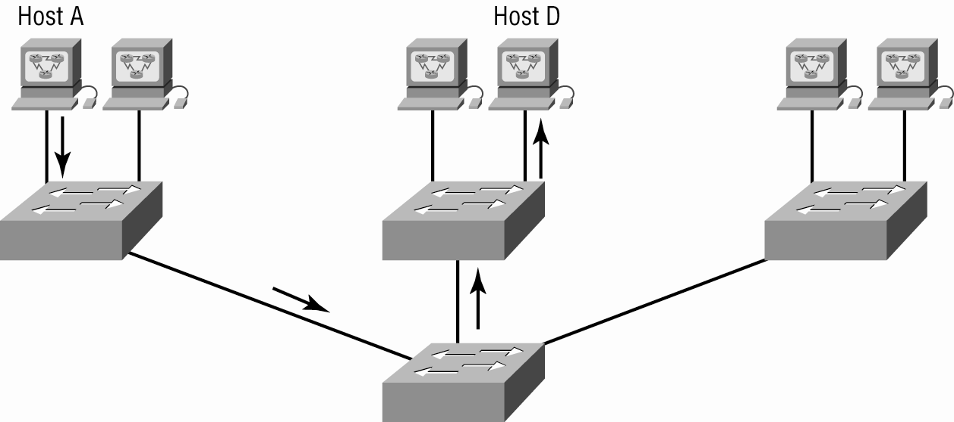
Switched Network

Slide 9
Security
Flat network problems
VLANs

Slide 10
Flexibility & Scalability
Layer-2 switches only read frames
  Can cause a switch to forward all broadcasts
VLANs
  Essentially create broadcast domains
    Greatly reduces broadcast traffic
    Ability to add wanted users to a VLAN regardless of their physical location
    Additional VLANs can be created when network growth consumes more bandwidth

Slide 11
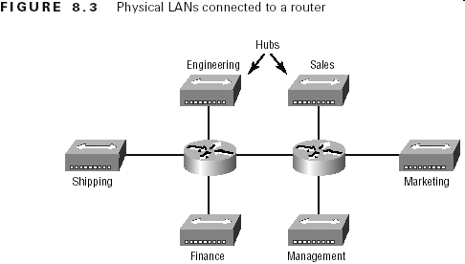
Physical LANs Connected To A Router

Slide 12
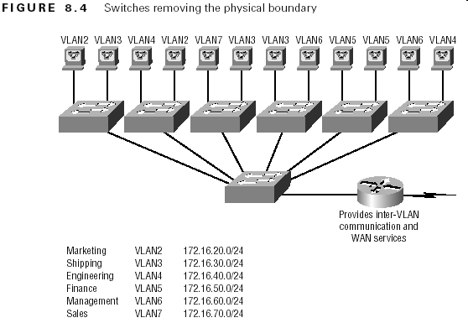
VLANs Remove The Physical Boundary

Slide 13
VLAN Memberships
Static VLANs
  Typical method of creating VLANs
  Most secure
    A switch port assigned to a VLAN always maintains that assignment until changed
Dynamic VLANs
  Node assignment to a VLAN is automatic
    MAC addresses, protocols, network addresses, etc
  VLAN Management Policy Server (VMPS)
    MAC address database for dynamic assignments
    MAC-address to VLAN mapping

Slide 14
Identifying VLANs
Access links
  A link that is part of only one VLAN
Trunk links
  Carries multiple VLANs

Slide 15
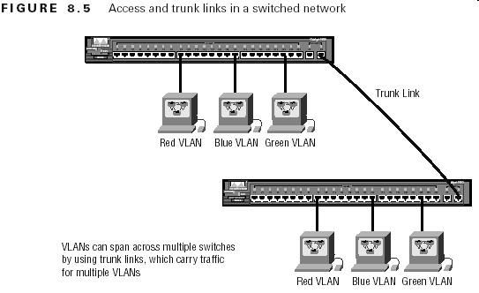
Identifying VLANs (cont.)

Slide 16
Frame Tagging
Definition: A means of keeping track of users & frames as they travel the switch fabric & VLANs
  User-defined ID assigned to each frame
  VLAN ID is removed before exiting trunked links & access links

Slide 17
VLAN ID Methods
Inter-Switch Link (ISL)
  Cisco proprietary
  FastEthernet & Gibabit Ethernet only
IEEE 802.1q
  Must use if trunking between Cisco & non-Cisco switch

Slide 18
Inter-Switch Link (ISL) Protocol
Definition: A means of explicitly tagging VLAN information onto an Ethernet frame
  Allows VLANs to be multiplexed over a trunk line
  Cisco proprietary
  External tagging process

Slide 19
VLAN Trunk Protocol (VTP)
Purpose: to manage all configured VLANs across a switch internetwork & maintain consistency
  Allows an administrator to add, delete, & rename VLANs

Slide 20
VTP Benefits
Benefits
  Consistent configuration
  Permits trunking over mixed networks
  Accurate tracking
  Dynamic reporting
  Plug-and-Play
A VTP server must be created to manage VLANs

Slide 21
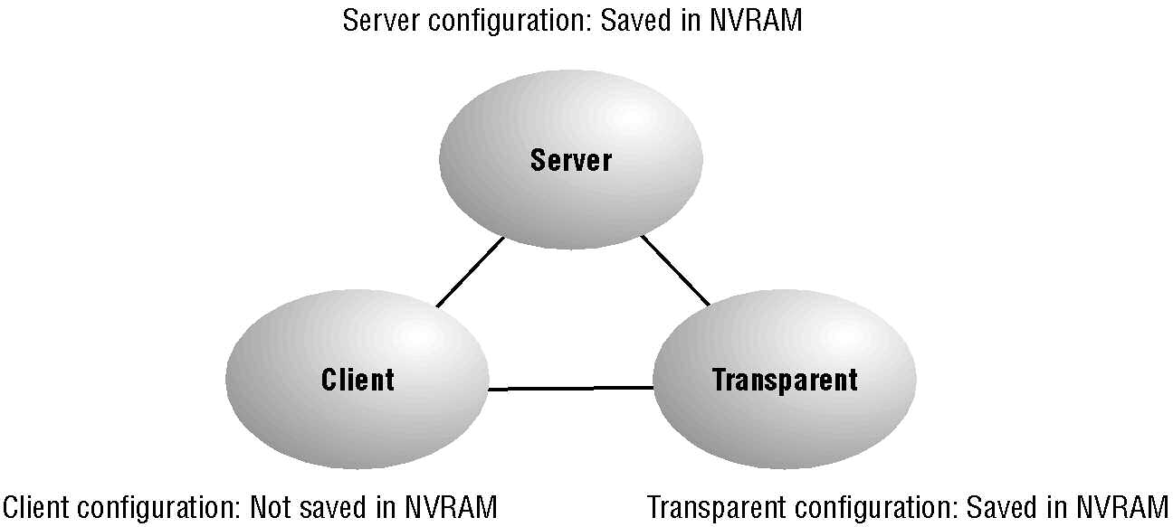
VTP Modes

Slide 22
VTP Modes of Operation
Server
  Default for all Catalyst switches
  Minimum one server for a VTP domain
Client
  Receives information + sends/receives updates
  Cannot make any changes
Transparent
  Does not participate in a VTP domain but forwards VTP advertisements
  Can add/delete VLANs
  Locally significant

Slide 23
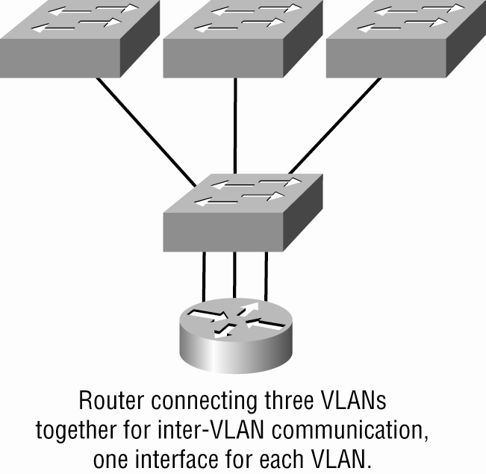
Router with Individual VLAN associations

Slide 24
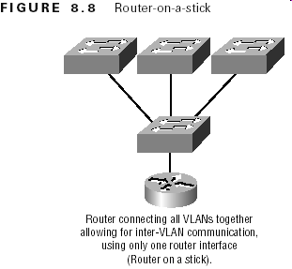
Routing Between VLANs

Slide 25
Configuring VLANs
Creating VLANs
Assigning Switch Ports to VLANs
Configuring Trunk Ports
Configuring Inter-VLAN routing

Slide 26
Creating VLANs
S1#config t
S1(config)#vlan ?
WORD ISL VLAN IDs 1-4094
internal internal VLAN
S1(config)#vlan 2
S1(config-vlan)#name Sales
S1(config-vlan)#vlan 3
S1(config-vlan)#name Marketing
S1(config-vlan)#vlan 4
S1(config-vlan)#name Accounting

Slide 27
Assigning Switch Ports to VLANs
S1#config t
S1(config)#int fa0/3
S1(config-if)#switchport mode access
S1(config-if)#switchport access vlan 3

Slide 28
Configuring Trunk Ports
2960 (802.1q)
S1#config t
S1(config)#int fa0/8
S1(config-if)#switchport mode trunk
3560 (ISL or IEEE 802.1Q)
Core(config-if)#switchport trunk encapsulation ?
dot1q Interface uses only 802.1q trunking encapsulation when trunking
isl Interface uses only ISL trunking encapsulation when trunking
negotiate Device will negotiate trunking encapsulation with peer on interface
Core(config-if)#switchport trunk encapsulation dot1q
Core(config-if)#switchport mode trunk

Slide 29
Configuring Inter-VLAN routing
Router(config)# interface fastethernet 0/1
Router(config-if)# no ip address
Router(config)# interface fastethernet 0/1.1
Router(config-if)# encapsulation dot1q 1
Router(config-if)# ip address 192.168.1.1 255.255.255.0
Router(config-if)# interface fastethernet 0/1.10
Router(config-if)# encapsulation dot1q 10
Router(config-if)# ip address 192.168.2.1 255.255.255.0

Slide 30
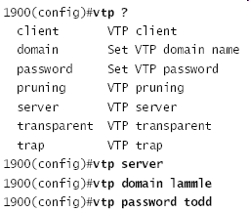
Configuring VTP
Switches are configured to be VTP servers by default.

Slide 31
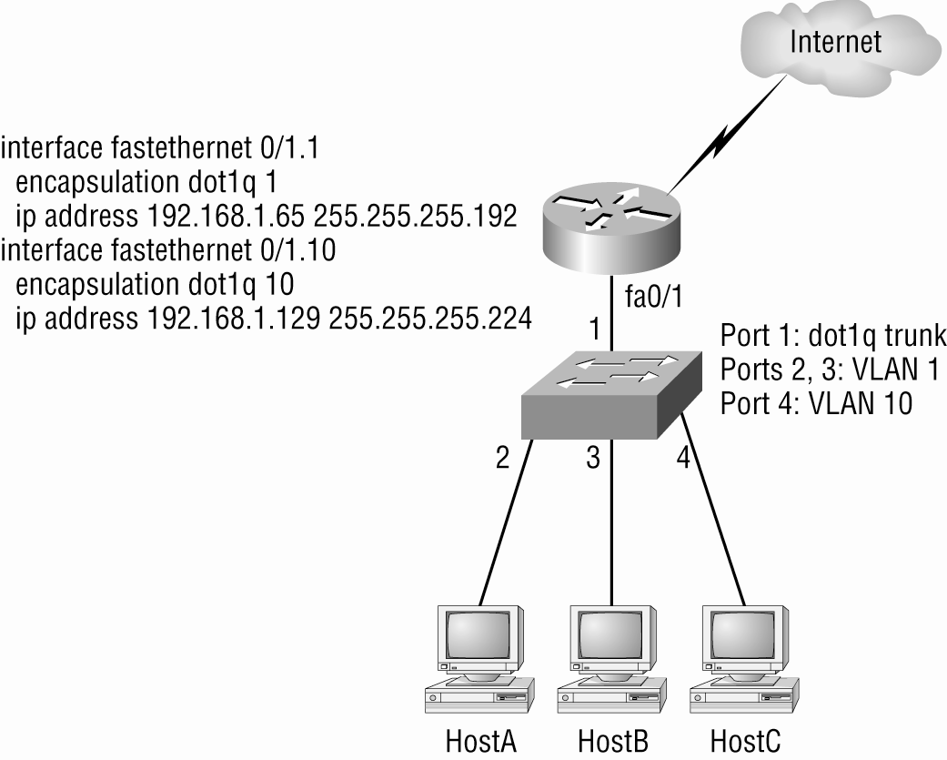
InterVLAN Configuration Example

Slide 32
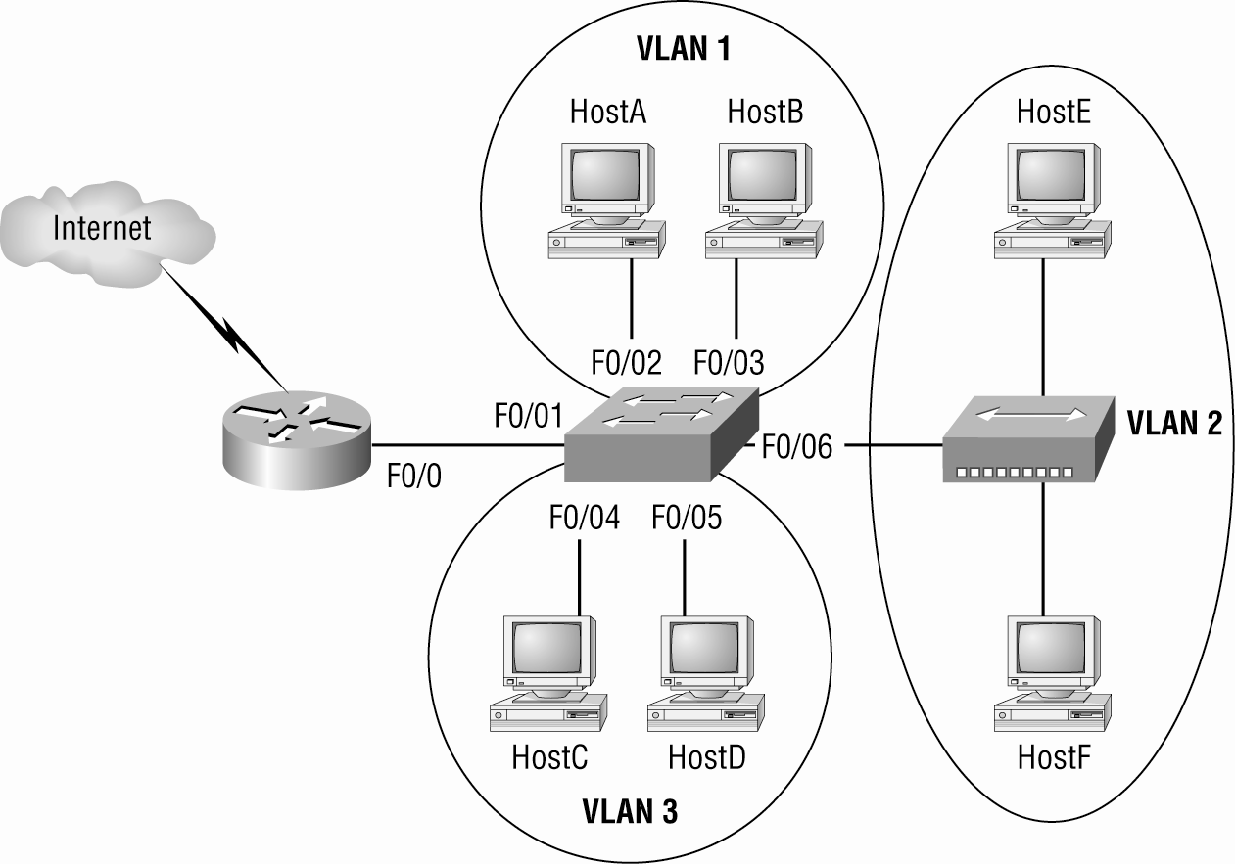
Example 2

Slide 33
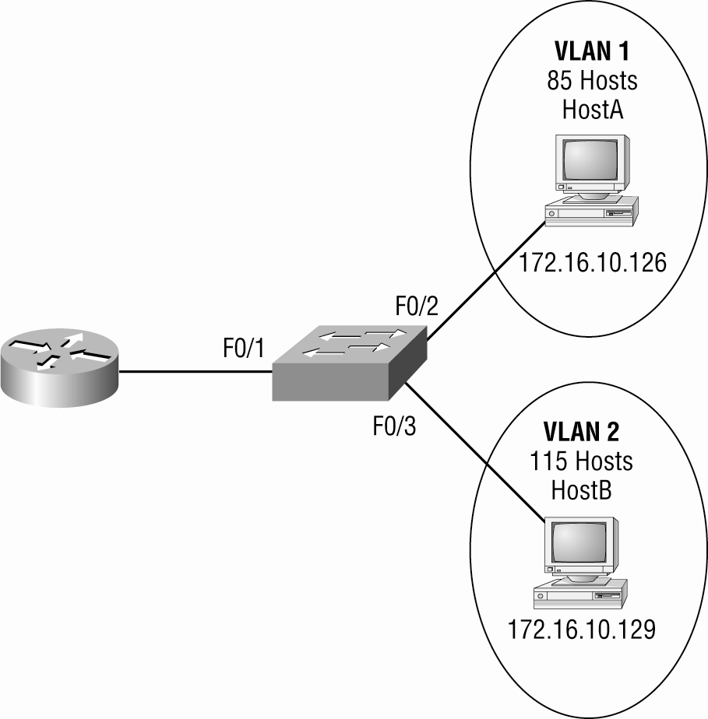
Example 3

Slide 34
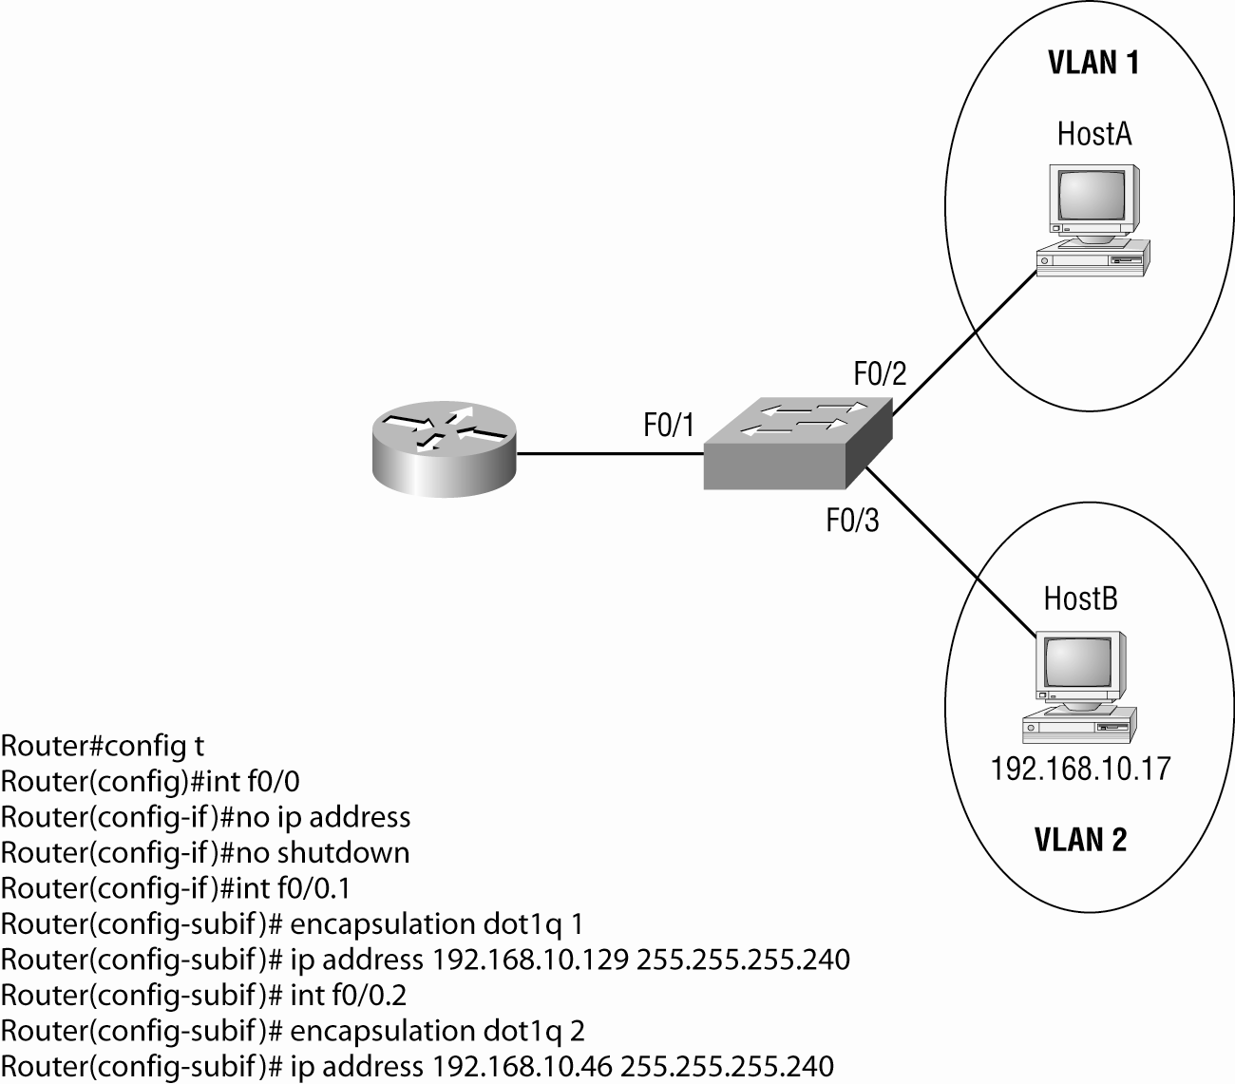
Example 4

Slide 35
Configuring VTP
Switches are configured to be VTP servers by default.

Slide 36
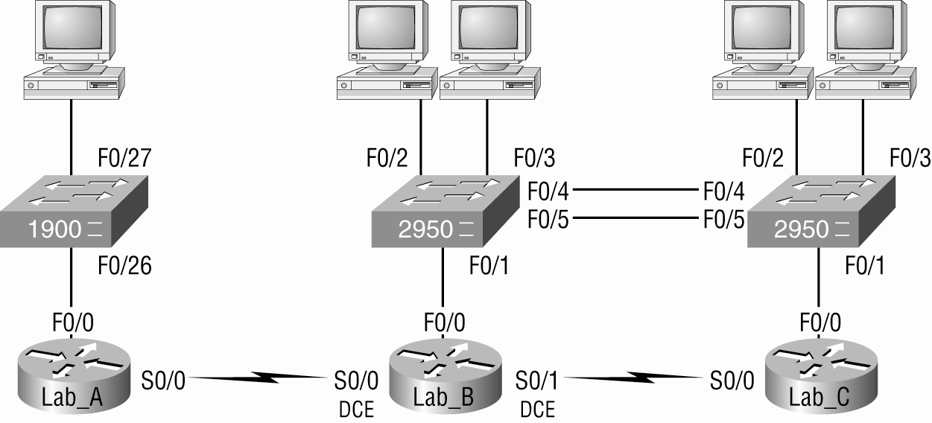
Configuring Switching A Sample Internetwork

Slide 37
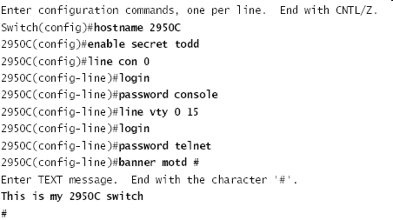
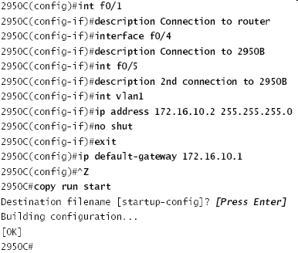
2950C

Slide 38
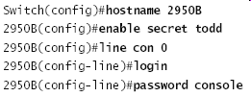
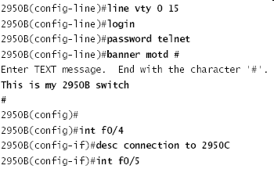
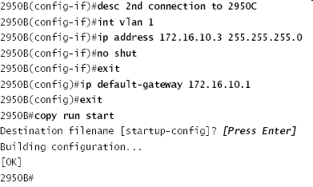
2950B

Slide 39
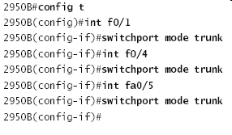
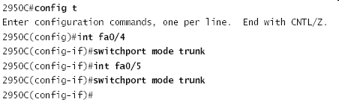
Setting Up Trunking

Slide 40
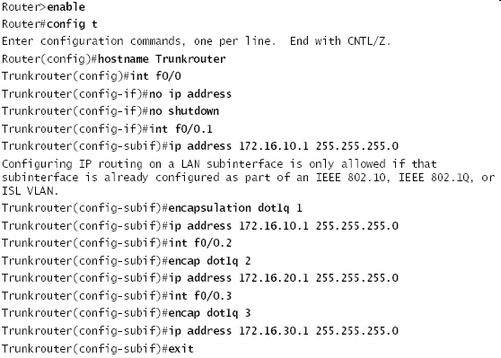
Inter-VLAN communication

Slide 41
Telephony: Configuring Voice VLANs
The voice VLAN feature enables access ports to carry IP voice traffic from an IP phone
You can configure access ports on the switch to send Cisco Discovery Protocol (CDP) packets that instruct an attached Cisco IP phone to send voice traffic to the switch in
any of these ways:
In the voice VLAN tagged with a layer 2 CoS priority value
In the access VLAN tagged with a layer 2 CoS priority value
In the access VLAN, untagged (no layer 2 CoS priority value)

Slide 42
Configuring the Voice VLAN
Switch#configure t
Switch(config)#mls qos
Switch(config)#interface f0/1
Switch(config-if)#switchport priority extend ?
cos Override 802.1p priority of devices on appliance
trust Trust 802.1p priorities of devices on appliance
Switch(config-if)#switchport priority extend trust
Switch(config-if)#mls qos trust cos
Switch(config-if)#switchport voice vlan dot1p
Switch(config-if)#switchport mode access
Switch(config-if)#switchport access vlan 3
Switch(config-if)#switchport voice vlan 10

Slide 43
Written Labs and Review Questions
  Open your books and go through all the written labs and the review questions.
  Review the answers in class.

